Slide 1
PBL – Project
FY BTech EXCP Semester II ( 2024-25)
Names | Roll Number
Mihir Parekh | 16014024051
Neel Parikh | 16014024052
Neal Wadekar | 16014024053
Jaineel Patel | 16014024054
Meeta Patil | 16014024055

Slide 2
Theme chosen for Project
Automation of Attendance Using RFID and ESP3266
This project leverages the power of Radio Frequency Identification (RFID) technology combined with the versatility of ESP3266 to create an automated attendance system. The goal is to minimize manual intervention, reduce errors, and streamline the process of tracking attendance in various environments such as educational institutions, corporate offices, and public facilities. By integrating these technologies, the system offers a cost-effective, scalable, and efficient solution for real-time attendance monitoring.

Slide 3
Need Statement
This project aims to improve attendance recording in large organizations by using RFID technology and ESP3266 Board.
RFID technology allows for contactless scanning of unique identification cards, while ESP3266 serves as the control hub.
This automated system minimizes manual effort, enhances data integrity, reduces fraudulent entries, and offers a scalable solution.

Slide 4

Problem Statement
List of Objectives:
Automate attendance tracking using RFID cards.
Ensure secure and authorized access.
Display attendance data on an LCD screen.
Constraints:
Limited to RFID technology and ESP3266 hardware.
Requires wired connections and power supply.
Functions:
Read RFID card data.
Validate against pre-stored information.
Update attendance records.
Provide feedback via buzzer.

Slide 5
Hardware / Software Requirements
Hardware:
ESP3266
RFID Reader and Tags
16x2 I2C LCD Display
Buzzer
Breadboard
Jumper Wires
Software:
Arduino UNO

Slide 6
Timeline Chart
Task | Week 1 | Week 2 | Week 3 | Week 4 | Week 5 | Week 6 | Week 7 | Week 8 | Week 9
Finalizing Project Idea
Research on Various Designs
Circuit Design and Procurement
Initial Testing of Software
Prototype and Debugging
Documentation and Presentation

Slide 7
Conceptual Designs
Rough Sketches / Model of possible solutions – 1 or 2 atleast

Slide 8
Literature Survey
Table of papers / Articles
Title with year of Publication | Authors | Methodology/ Algoritham | Key Results / Findings | Remarks ( Based on your understating) | Link for article

Slide 9
Block Diagram of Project
Diagram
Add Function / Need of each block

Slide 10
Project Cost Sheet
Name of Component | Specifications | Approximate cost
ESP3266 |  | 450
RFID Reader |  | 130
RFID Tags
16 x 2 C LCD Display |  | 250
Buzzer |  | 20
Breadboard |  | 80
Jumper Wires |  | 80
Total |  | 1010

Slide 11
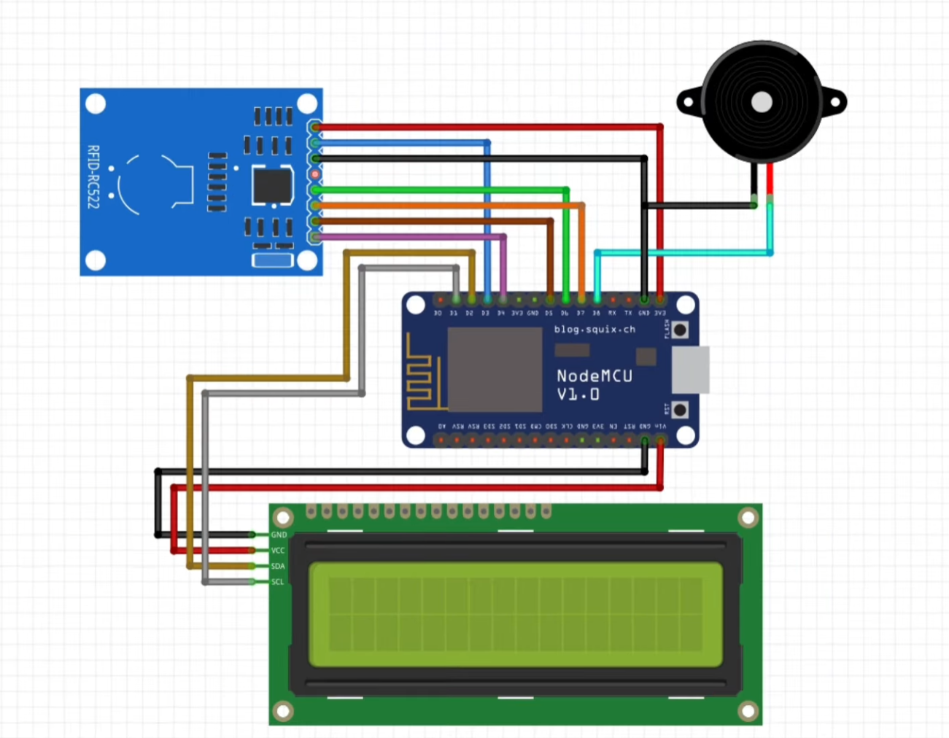
Proposed Circuit / Connection Diagram

Slide 12
Project Status
Work Completed till Date
Work To be completed

Slide 13
Results
Add photographs / Video link of your model

Slide 14
Results
Additional results / Observations/ Limitations

Slide 15
Results
Objective / Function | Achieved / Not Achived | Remarks ( If Achived range or accuracy . If not achived , justify probable reason

Slide 16
References
http://circuitdigest.com/tags/rfid
http://circuitdigest.com/microcontroller-projects/rfid-based-attendance-system

